Slide 1
Chapter -2
Chapter 2 Processes and Threads

Slide 2
Process Concepts
Program
A program is a piece of code which may be a single line or millions of lines.
A computer program is usually written by a computer programmer in a programming language.
A computer program is a collection of instructions that performs a specific task when executed by a computer.
When we compare a program with a process, we can conclude that a process is a dynamic instance of a computer program.

Slide 3
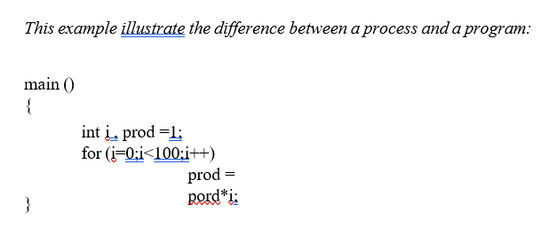
Process Concepts
A process is an instance of a program in execution.
A program becomes process when executable file is loaded in the main memory.
A process is defined as an entity which represents the basic unit of work to be implemented in the system. Each process has its own address space and process control block (PCB).
It is a program containing one multiplication statement (prod = prod * i) but the process will execute100 multiplication, one at a time through the 'for' loop.

Slide 4
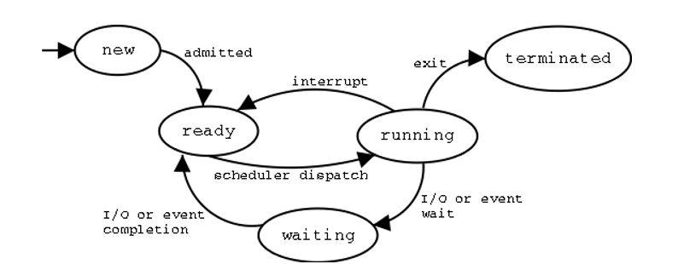
Process states and its transition
When a process executes, it passes through different states. These stages may differ in different operating systems, and the names of these states are also not standardized. In general, a process can have one of the following five states at a time.

Slide 5
Process states and its transition
Start: This is the initial state when a process is first started/created.
Ready: The process is waiting to be assigned to a processor. Ready processes are waiting to have the processor allocated to them by the operating system so that they can run. Process may come into this state after Start state or while running it by but interrupted by the scheduler to assign CPU to some other process.
Running: Once the process has been assigned to a processor by the OS scheduler, the process state is set to running and the processor executes its instructions.
Waiting: Process moves into the waiting state if it needs to wait for a resource, such as waiting for user input, or waiting for a file to become available.
Terminated or Exit: Once the process finishes its execution, or it is terminated by the operating system, it is moved to the terminated state where it waits to be removed from main memory.

Slide 6
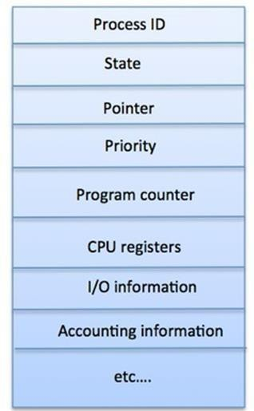
Process Control Block (PCB)
A Process Control Block is a data structure maintained by the Operating System for every process. The PCB is identified by an integer process ID (PID). The PCB is maintained for a process throughout its lifetime, and is deleted once the process terminates. A PCB keeps all the information needed to keep track of a process as listed in the figure:
Process State: The current state of the process i.e., whether it is ready, running, waiting, or whatever.
Pointer: A pointer to parent process.
Priority: Contains the priority numbers of each process.
Program Counter: Program Counter is a pointer to the address of the next instruction to be executed for this process.
CPU registers: Various CPU registers where process need to be stored for execution for running state.
IO status information: This includes a list of I/O devices allocated to the process.
Accounting information: This includes the amount of CPU used for process execution, time limits, execution ID etc
CPU Scheduling Information: Process priority and other scheduling information which is required to schedule the process.
Memory management information: This includes the information of page table, memory limits, Segment table depending on memory used by the operating system.

Slide 7
Concurent processing and Parllel processing
Concurrent processing
Concurrent processing means multiple tasks make progress during the same time period.
Tasks are divided into smaller subtasks so they can be worked on without waiting for each other.
These subtasks may be switched rapidly by one processor OR may run on different processors.
It does not require multiple processors even one CPU can handle multiple tasks by switching between them.
It gives the illusion that tasks are running at the same time, even if they are not exactly simultaneous.
Used to improve responsiveness, multitasking, and to handle many processes efficiently.
Parallel processing
Parallel processing means two or more CPUs execute instructions at the exact same time.
it is a form of multiprocessing and tasks are broken down and run simultaneously on different processors.
Requires multiple cores or multiple processors

Slide 8
Race Condition
A situation where several processes/threads access and manipulate the same data concurrently and the outcome of the execution depends on the particular order in which the access takes place, is called a race condition. A race condition occurs when two or more threads can access shared data and they try to change it at the same time.
Possibilities of race:
many concurrent process read the same data.
one process reading and another process writing same data.
two or more process writing same data.
To guard against the race conditions, we need to synchronize the processes in such a way that only one process at a time can be manipulating shared variable or file. This is called mutual exclusion (i.e. critical section is executed as an atomic instruction).

Slide 9
Critical section
A critical section is a part of a program where shared resources (like memory, files, or variables) are accessed by multiple processes or threads. To avoid problems such as race conditions and data inconsistency, only one process/thread should execute the critical section at a time using synchronization techniques. This ensures that operations on shared resources are performed safely and predictably.
Structure of a Critical Section
1. Entry Section
The process requests permission to enter the critical section.
Synchronization tools (e.g., mutex, semaphore) are used to control access.
2. Critical Section: The actual code where shared resources are accessed or modified.
3. Exit Section: The process releases the lock or semaphore, allowing other processes to enter the critical section.
4. Remainder Section: The rest of the program that does not involve shared resource access.

Slide 10
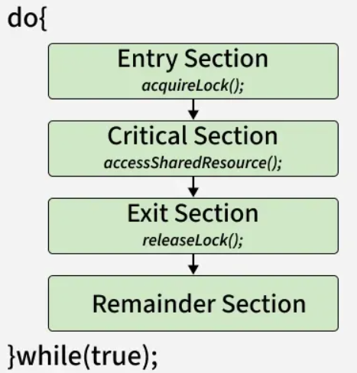
Requirements of Critical Section Solutions
1. Mutual Exclusion
At most one process can be inside the critical section at a time.
Prevents conflicts by ensuring no two processes update the shared resource simultaneously.
2. Progress
If no process is in the critical section, and some processes want to enter, the choice of who enters next should not be postponed indefinitely.
Ensures that the system continues to make progress rather than getting stuck.
3. Bounded Waiting
There must be a limit on how long a process waits before it gets a chance to enter the critical section.
Prevents starvation, where one process is repeatedly bypassed while others get to execute.

Slide 11
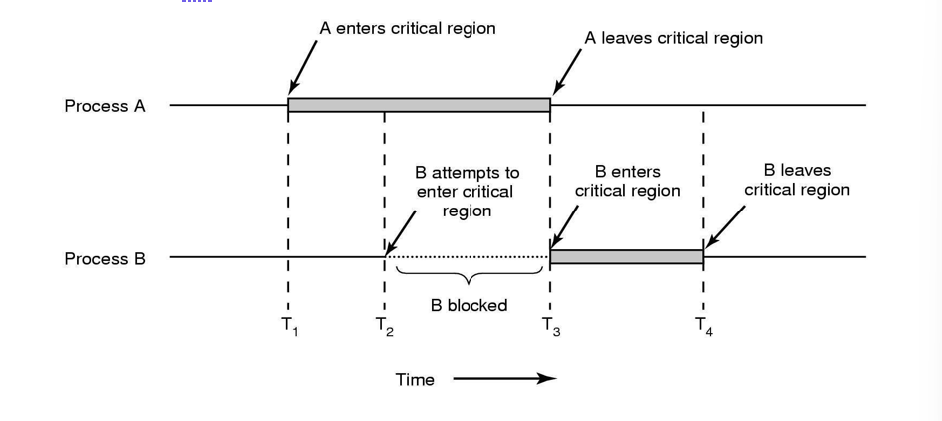
Mutual Exclusion
A mutual exclusion (mutex) is a program object that prevents simultaneous access to a shared resource.
Mutual exclusion is a property of concurrency control, which is instituted for the purpose of preventing race conditions.
It is the requirement that one thread of execution never enter its critical section at the same time that another concurrent thread of execution enters its own critical section

Slide 12
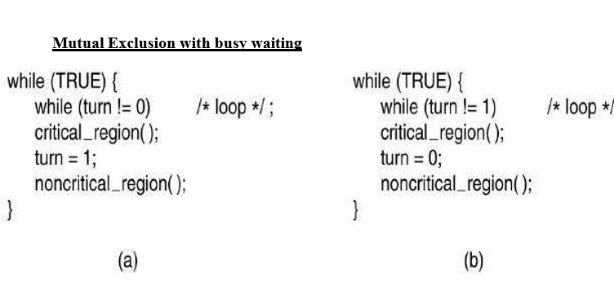
Mutual Exclusion

Slide 13
Mutual; exclusion
In this proposed solution, the integer variable ‘turn’ keeps track of whose turn is to enter the critical section.
Initially turn = 0. Process 1 inspects turn, finds it to be 0 and enters in its critical section. Process 2 also finds it to be 0 and therefore sits in a loop continually testing ‘turn’ to see when it becomes 1.
Continuously testing a variable waiting for some value to appear is called the busy waiting.
When process 1 exit from the critical region is set to turn to 1 and now process 2 can find it to be 1 and enters into the critical region.
Also, in this way both the process get the alternate turn to enter in the critical region.
Taking turns is not a good idea when one of the processes is much slower than the other.
Can used only when the waiting period is expected to be short

Slide 14
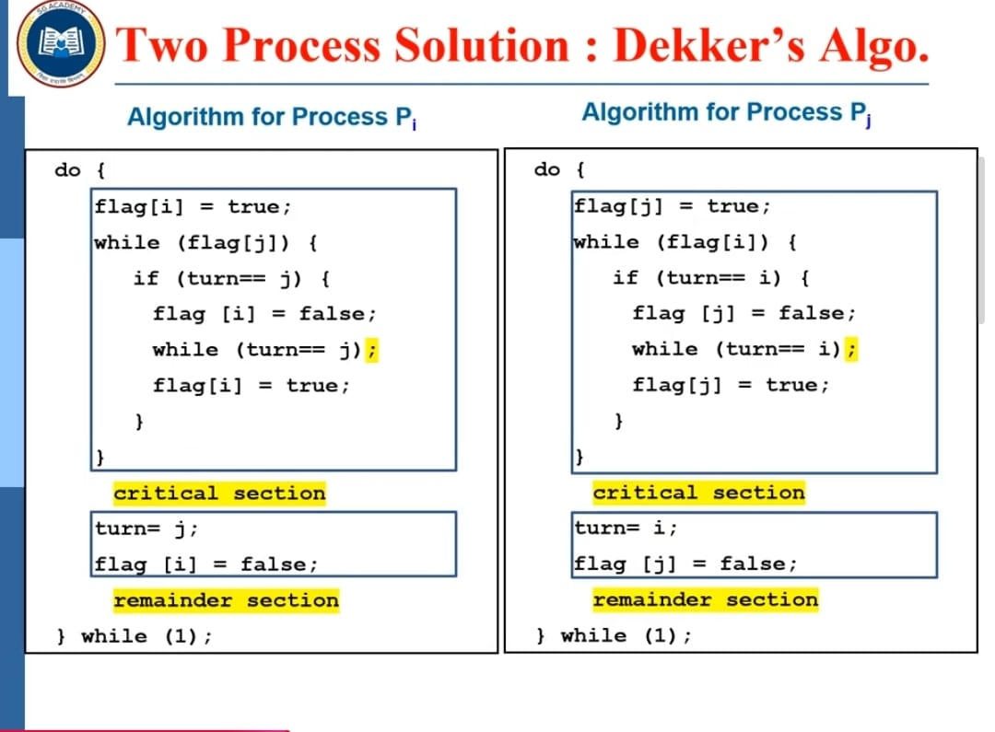
Dekers solution

Slide 15
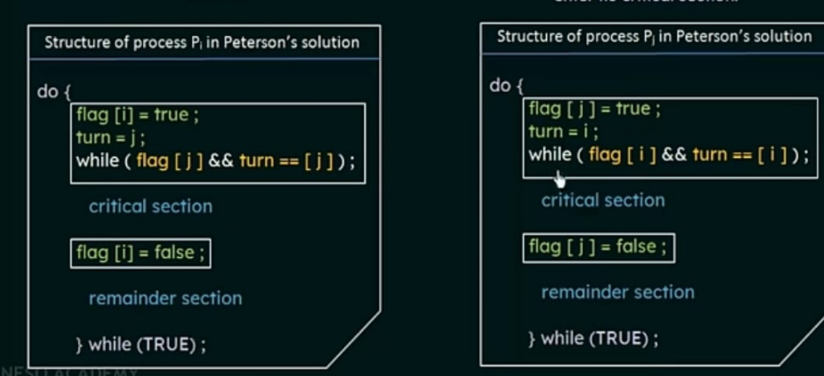
Peterson solution

Slide 16
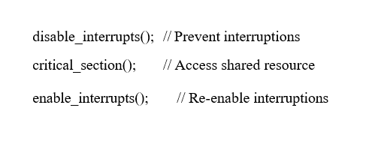
Disabling Interrupts
Disabling interrupts is a low-level mechanism to ensure that the CPU is not interrupted while executing a critical section of code. This guarantees that no other process or interrupt handler can access shared resources during this period.
The CPU has an interrupt-enable flag.
Disabling interrupts sets this flag to prevent the CPU from responding to any external or internal interrupts.
The critical section executes without being preempted.
After the critical section completes, interrupts are re-enabled.
Steps:
Disable interrupts before entering the critical section.
Execute the critical section.
Re-enable interrupts after leaving the critical section.

Slide 17
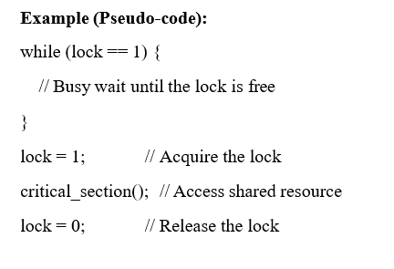
Lock Variable
Lock variables are a higher-level software mechanism used to coordinate access to a shared resource between multiple processes or threads.
A lock ensures that only one process or thread can access the critical section at any given time.
How it Works
A shared variable (the lock) is used to indicate the state of the critical section:
0 (unlocked): No process is in the critical section.
1 (locked): A process is in the critical section.
Before entering the critical section, a process checks the lock:
If unlocked, it sets the lock and proceeds.
If locked, it waits until the lock is released.
Steps:
Check the value of the lock variable.
If it is 0, set it to 1 (lock it) and enter the critical section.
After exiting the critical section, reset the lock to 0 (unlock it).

Slide 18
Test-and-Set Lock
Test-and-Set Lock (TSL) is a hardware-supported instruction used to implement mutual exclusion in multi- process systems. It ensures atomicity, making it a powerful primitive for synchronization.
The Test-and-Set instruction atomically performs the following actions:
1.Reads the value of a memory location (e.g., a lock variable).
2.Sets the value of that memory location to true (locked).
The atomicity ensures that no other process can interfere during the read-and-set operation, making it suitable for implementing locks.
How TSL Works
Shared Lock Variable:
A shared boolean variable lock is used:
false: The lock is free.
true: The lock is taken.
Test-and-Set Instruction:
Syntax (in pseudo-assembly):
TEST_AND_SET(register, lock)
register: Temporary register to store the old value of lock.
lock: The memory location to be modified.

Slide 19
Test and set lock
while (TRUE) {
// Entry section
while (test_and_set(&lock) == 1) {
; // busy waiting until lock becomes free
}
// ---- CRITICAL SECTION ----
<critical section code>
// Exit section
lock = 0 // release lock
// ---- REMAINDER SECTION ----
<remainder section>
}

Slide 20
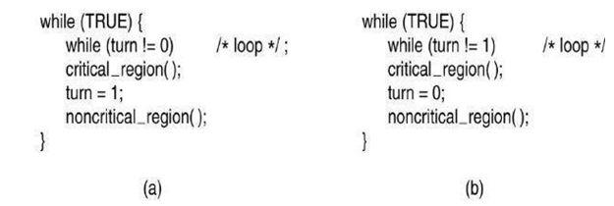
Strict Alternation
In this approach, we have an integer variable named turn, which keeps track of whose turn is it to enter critical section
Say, in a two process scenario, Process 0 runs when turn=0 and process 1 runs when turn=1.
Turn is initially set to 0
Process 0 examines turn to be 0 and enters the critical region.
Process 1 also finds turn to be 0 so it sits in a tight
loop continually testing turn to see when it becomes 1.
Continuously testing a variable until some value appears is called busy waiting
When process 0 leaves the critical region, it
Set turn to 1 so that process 1 can now enter the critical region.
Problem
If process 0 finishes its work in non-critical region fast enough after it set, turn to 1 and process 0needs to enter critical section again before process 1 then it cannot do so. So, process 1 which is running outside critical region is blocking process 0.

Slide 21
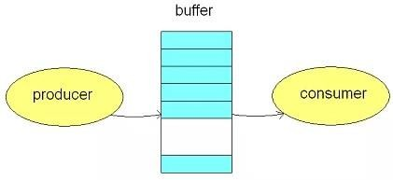
Producer-consumer problem
Producer-consumer problem (also known as the bounded-buffer problem) is a multiprocessing synchronization problem.
The problem describes two processes, the producer and the consumer, who share a common, fixedsize buffer.
Producer: - The producer's job is to generate a piece of data, put it into the buffer and start again.
Consumer: - The consumer is consuming the data (i.e., removing it from the buffer) one piece ata time.
Problem
The problem is to make sure that the producer won't try to add data into the buffer if it's full andthat the consumer won't try to remove data from an empty buffer.
Solution to Producer-consumer problem
Producer either go to sleep or discard data if the buffer is full. The next time the consumer removes an item from the buffer and it notifies the producer who starts to fill the buffer again consumer can go to sleep if it finds the buffer to be empty. The next time the producer puts data into the buffer, it wakes up the sleeping consumer

Slide 22
Sleep and wakeup
When a process wants to enter its critical region, it checks to see if entry is allowed, if it is not, the process just sits in a tight loop waiting, this approach wastes CPU time.
We could use an IPC primitives that blocks a process instead of wasting CPU time when they are not allowed to enter into their critical section.
Such a simple primitive pair is sleep and wakeup
Essentially, when a process is not permitted to access its critical section, it uses a system call known as Sleep, which causes that process to block.
The process will not be scheduled to run again, until another process uses the Wakeup system call.
Wakeup is called by a process when it leaves its critical section if any other processes have blocked.

Slide 23
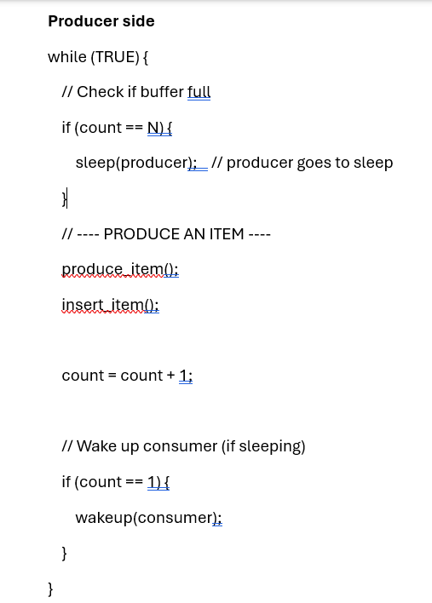
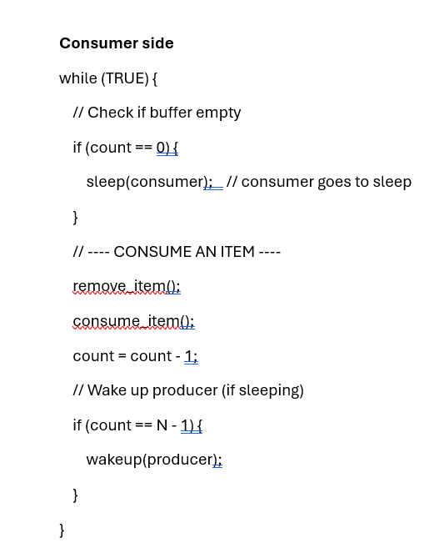
Sleep and wakeup

Slide 24
Problem with sleep and wakeup
The sleep and wakeup problem occurs when a wakeup signal is sent before the receiving process goes to sleep. Since the signal is not stored, it gets lost, and the process sleeps forever. This leads to a deadlock, because no other process can wake it up again.
Consumer: checks empty → about to sleep
Producer: produces → wakeup sent (lost)
Consumer: sleeps
Producer: waits
System stuck forever

Slide 25
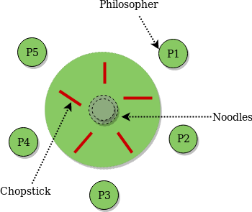
Classical IPC problems(The Dining Philosophers Problem)
The dining philosophers’ problem is a classic synchronization problem which is used to evaluate situations where there is a need of allocating multiple resources to multiple processes.
Consider there are five philosophers sitting around a circular dining table. The dining table has five chopsticks and a bowl of noodles in the middle as shown in the below figure. At any instant, a philosopher is either eating or thinking. When a philosopher wants to eat, he uses two chopsticks - one from their left and one from their right. When a philosopher wants to think, he keeps down both chopsticks at their original place.

Slide 26
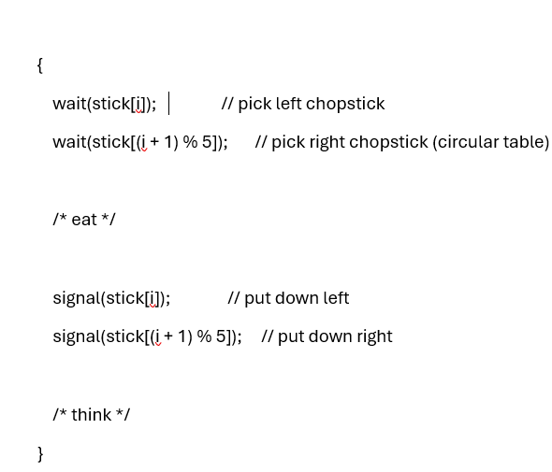
The Dining Philosophers Problem
From the problem statement, it is clear that a philosopher can think for an indefinite amount of time. But when a philosopher starts eating, he has to stop at some point of time. The philosopher is in an endless cycle of thinking and eating.
An array of five semaphores, stick[5], for each of the five chopsticks.The code for each philosopher looks like:

Slide 27
The Dining Philosophers Problem
When a philosopher wants to eat the rice, he will wait for the chopstick at his left and picks up that chopstick. Then he waits for the right chopstick to be available, and then picks it too. After eating,he puts both the chopsticks down.
But if all five philosophers are hungry simultaneously, and each of them pickup one chopstick, then a deadlock situation occurs because they will be waiting for another chopstick forever. The possible solutions for this are:
A philosopher must be allowed to pick up the chopsticks only if both the left and right chopsticks are available.
Allow only four philosophers to sit at the table. That way, if all the four philosophers pick up four chopsticks, there will be one chopstick left on the table. So, one philosopher can start eating and eventually, two chopsticks will be available. In this way, deadlocks can beavoided.

Slide 28
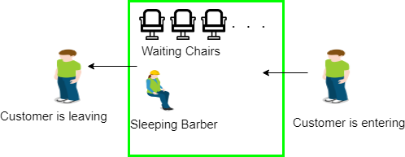
Sleeping Barber problem
The analogy is based upon a hypothetical barber shop with one barber. There is a barbershop which has one barber, one barber chair, and n chairs for waiting for customers if there are any to sit on the chair.
If there is no customer, then the barber sleeps in his own chair. When a customer arrives, he has to wake up the barber
If there are many customers and the barber is cutting a customer’s hair, then the remaining customers either wait if there are empty chairs in the waiting room or they leave if no chairs are empty

Slide 29
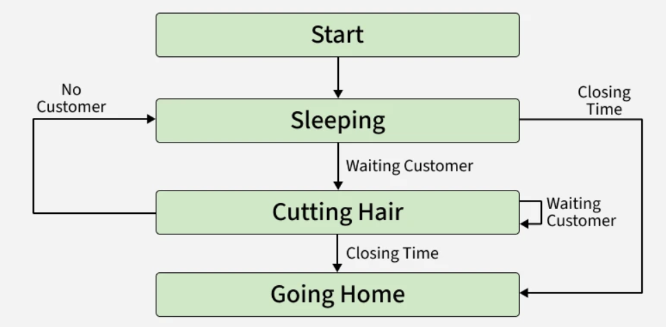
Sleeping Barber problem

Slide 30
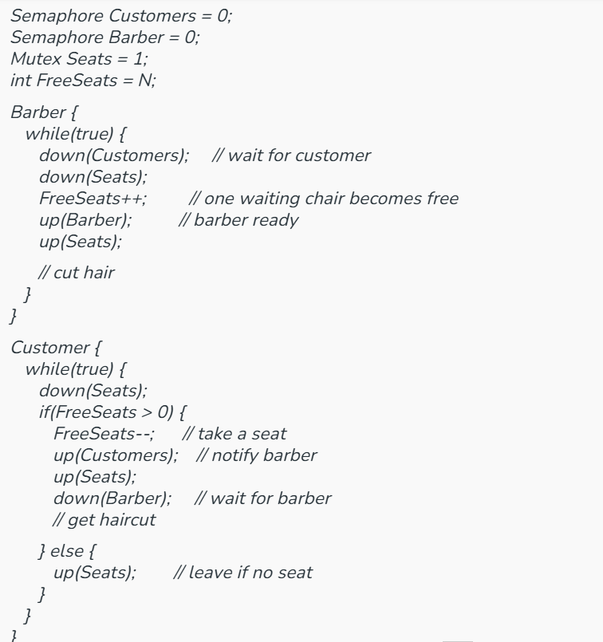
Sleeping Barber problem
The challenge is to safely synchronize customers and the barber so that:
Only one customer is in the barber’s chair at a time.
Customers either wait or leave when seats are full.
The barber works when customers are available and sleeps otherwise.
Synchronization Solution
We use three semaphores:
Customers counts waiting customers.
Barber signals when the barber is ready.
Mutex ensures mutual exclusion when accessing chairs.

Slide 31
Sleeping Barber problem
Customers counts waiting customers, Barber signals barber availability, Seats (mutex) protects chair count, and FreeSeats = N tracks empty chairs.
Barber loop: Waits (down(Customers)) until a customer arrives. Locks seats, frees one chair (FreeSeats++), signals the barber is ready (up(Barber)), unlocks seats, and cuts hair.
Customer loop: Locks seats. If a chair is free (FreeSeats > 0), takes it (FreeSeats--), notifies barber (up(Customers)), unlocks seats, then waits for barber (down(Barber)) to get haircut. If no seat is free, unlocks seats and leaves.

Slide 32
Readers-Writers Problem
The Readers-Writers Problem is a classic synchronization issue in operating systems. It deals with coordinating access to shared data (e.g., database, file) by multiple processes or threads.
Readers: Multiple readers can read the shared data simultaneously without causing inconsistency (since they don’t modify data).
Writers: Only one writer can access the data at a time, and no readers are allowed while writing (to prevent data corruption).
The challenge is to design a synchronization scheme that ensures:
Multiple readers can access data together if no writer is writing.
Writers have exclusive access no other reader or writer can enter during writing.
variants of the Problem
1. Readers Preference
Readers are given priority.
No reader waits if the resource is available for reading, even if a writer is waiting.
Writers may suffer from starvation.
2. Writers Preference
Writers are prioritized over readers.
Ensures writers won’t starve, but readers may wait longer.

Slide 33
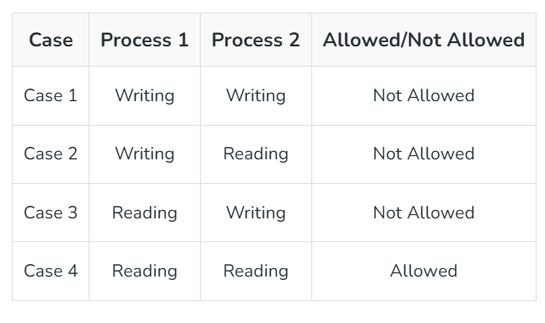
Readers-Writers Problem
Here priority means, no reader should wait if the shared resource is currently open for reading. There are four types of cases that could happen here.

Slide 34
Readers-Writers Problem
Synchronization Variables
mutex: Ensures mutual exclusion when updating the reader count (readcnt).
wrt: Controls access to the shared data (used by both readers and writers).
readcnt: Number of readers currently in the critical section.
Semaphore Operations
wait(): Decreases semaphore value, blocks if < 0.
signal(): Increases semaphore value, wakes waiting process if any.
Reader Process(Reader Preference)
1. Reader requests the entry to critical section.
2. If allowed:
it increments the count of number of readers inside the critical section. If this reader is the first reader entering, it locks the wrt semaphore to restrict the entry of writers if any reader is inside.
It then, signals mutex as any other reader is allowed to enter while others are already reading.
After performing reading, it exits the critical section. When exiting, it checks if no more reader is inside, it signals the semaphore "wrt" as now, writer can enter the critical section.
3. If not allowed, it keeps on waiting.

Slide 35
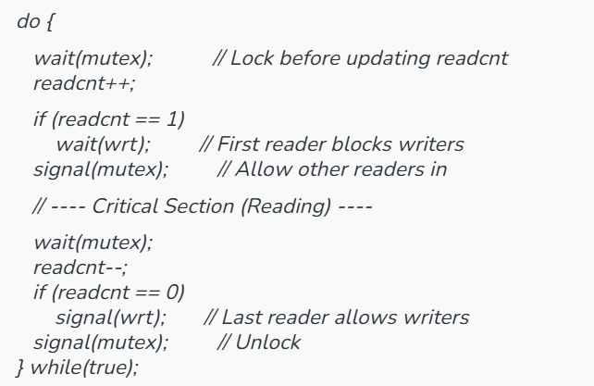
Readers process
When a reader enters, it locks mutex to update readcnt.
If it’s the first reader, it locks wrt so writers are blocked.
Multiple readers can now read the data simultaneously.
When a reader exits, it decrements readcnt.
If it’s the last reader, it unlocks wrt so writers can proceed.
The first reader blocks writers, the last reader allows writers, and all readers in between share the resource. This gives preference to readers, but writers may starve.

Slide 36
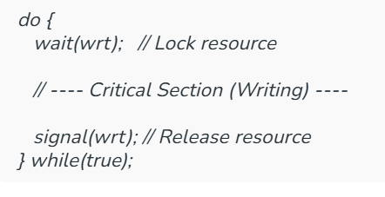
Writers Process
wait(wrt): Writer locks the resource to get exclusive access.
Critical Section: Writer performs writing (no other reader or writer can enter).
signal(wrt): Writer releases the resource after finishing.
Only one writer can write at a time, and no readers are allowed while writing. This ensures data integrity.
The Readers-Writers Problem highlights the need for proper synchronization when multiple processes access shared data.
Readers Preference solution allows many readers to access simultaneously while blocking writers, improving read efficiency.
However, writers may starve if readers keep arriving continuously.
To avoid this, Writers Preference or a Fair solution (using queues or advanced semaphores) can be used to ensure no starvation and balanced access.

